Slide 1
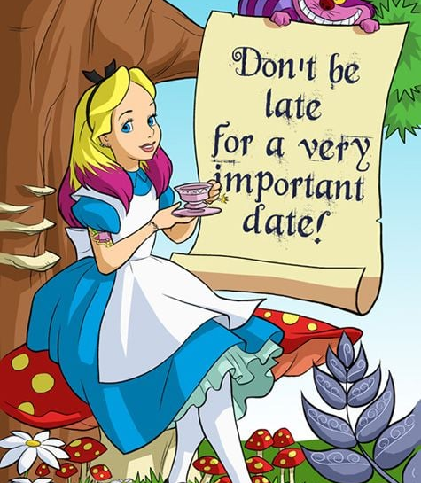
Join Us For A
Mad Hatter Evergreen Par-Tee
Hosted By Singapore Ladies Golf Association
Wednesday, 31st May, 2023
PM Game and Dinner
Course: Keppel Sime
Price for SLGA Evergreen Member: $160 *
( Green fee, Buggy, Makan Kechil & GST)
* same rate for Keppel Evergreen members
Closing Date: 5th May, 2023
There will be golf, novelty and lucky draw prizes
Note:Please register individually using the link below:
https://forms.gle/xRFgC1KsBFEN6AN9A

